Slide 1
Welcome to SeNSS: the South East Network for Social Sciences Prof Ismene Gizelis (Director)

Slide 2
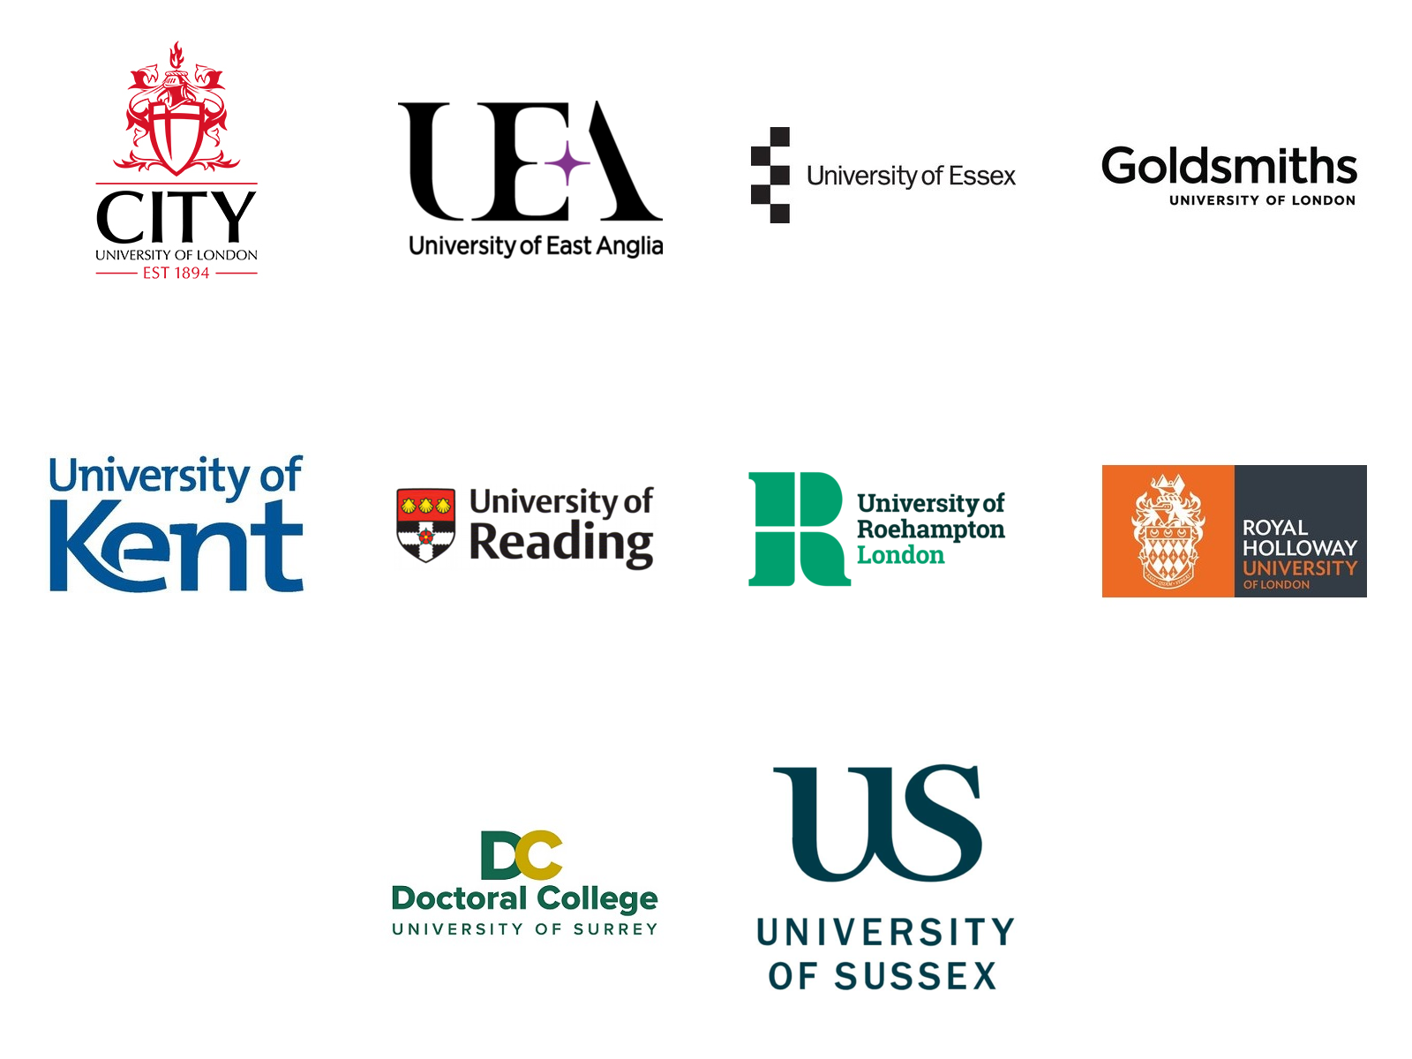

Slide 3
What is SeNSS?
One of 14 ESRC funded Doctoral Training Partnerships (DTPs)
Consortium of 10 universities
Offering 13 pathways, training and collaboration
Fully funded doctoral studentships (c40 per year); post-doctoral fellowships (6 per year); funding for new soc sci initiatives and ideas

Slide 4
Why SeNSS?
Why SeNSS?
Excellent supervisors or mentors from leading social sciences departments
Access to high quality training including advanced quantitative skills
Excellent network of external partners including government departments, industry and NGOs
Engaged student and fellow community
These networks and connections will help you to launch your career within, or outside, academia.

Slide 5
SeNSS context
SeNSS context
ESRC
£257 million (2021-22 data)
supporting c4,000 ec/soc researchers inc PGR
part of UKRI (UK Research and Innovation)
Executive chair: Prof Alisson Park
UKRI = UK Research and Innovation
7 Research Councils
Innovate UK
Research England
Department for Business, Energy and Industrial Strategy
Aims:
Foster research and development in UK
Create a positive "impact"

Slide 7
SeNSS Collaborations
SeNSS Collaborations
Links and joint-funded initiatives through:
NERC
AHRC
Centres for Doctoral Training (CDTs)
Joint events with other DTPs (e.g. training, Black History Month)
IAA Business Boost (completed September 2021)
Collaborative studentships

Slide 8
SeNSS core team
SeNSS core team
The SeNSS core team and office is based at the University of Essex, which is the co-ordinating university for SeNSS:
Director: Professor Ismene Gizelis (U of Essex)
Deputy Director: Professor Fragkiskos Filippaios (UEA)
Manager: Dr Felicity Szesnat
Co-ordinator: Rachel Leighton-Jones
Financial administrator: Sarah McKenzie
Additional assistance from Essex Postgraduate Research Education (PGRE) team

Slide 9
SeNSS Director
SeNSS Director
Professor in the Department of Government; PhD in Politics and Economics
Research interests: Systematic study of
Conflict dynamics
Peacekeeping
Gender equality and post-conflict development
Development and security
Research approach:
Quantitative methods
Field work (Liberia, Myanmar)
https://tigizelis.wordpress.com/

