Slide 1
The SeNSS PhD Student Journey Professor Fragkiskos Filippaios SeNSS Deputy Director – Professor of International Business, UEA October 2022

Slide 2
Outline
The nature of the PhD
Development of critical skills
Researcher Development Framework
The PhD as a journey
Training Needs Analysis
SeNSS Training
Overseas Institutional Visits
Placements

Slide 3
The nature of the PhD (I)
Reputedly began in at the University of Paris in the mid-12th century;
Conferred licence to practise in the professions of law, medicine and theology;
First mention in print was in 1207 in a letter from Pope Innocent 111 to King John of England, defending Stephen Langton’s candidature for Archbishop of Canterbury because, among other things, he had a doctorate in theology.

Slide 4
The nature of the PhD (II)
In late 18th and early 19th centuries, new ideas about the functions of universities advanced particularly in the German states by Fichte, Schliermacher, Von Humboldt ;
In 1808 Von Humboldt appointed to office in Prussia with responsibility for education and started:
‘...to create an entirely new type of academic institutional order and a new type of academic ...’ (Nybom 2003: 152)
the new order was represented by the University of Berlin which in 1810 became the world’s first explicitly research-led university;

Slide 5
The nature of the PhD (III)
The new type of academic was to be both a researcher and a teacher;
To qualify as a researcher, had to complete a new type of doctorate, one to be awarded for making an original contribution to knowledge and understanding in the sciences;
The new doctorate was to be awarded not in the old professional fields but in ‘Die mutter allerWissenschaften’ (the mother of all sciences), namely philosophy;
Subsequently became known as the ‘Humboldtian’ doctorate.

Slide 6
Common Assumptions
Students who obtain PhDs want to become professors.
Only the best doctoral students become professors.
The career paths of PhDs are linear (i.e. PhD to assistant > associate > full professor).
(Nerad et al, 2009)

Slide 7
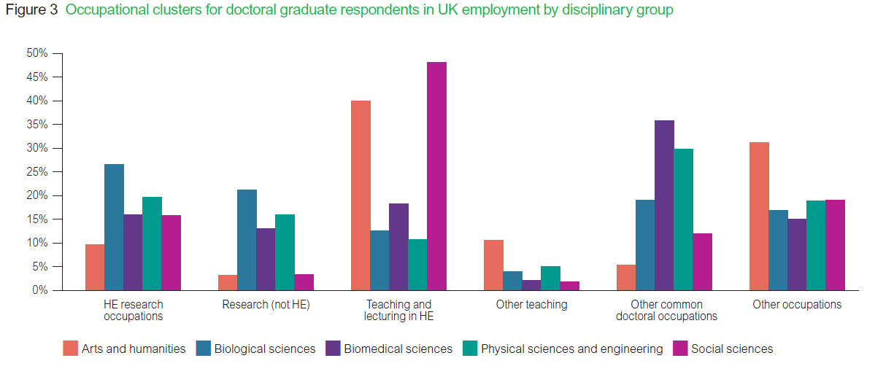
Doctoral destinations
https://www.vitae.ac.uk/impact-and-evaluation/what-do-researchers-do

Slide 8
Purpose of the student
Instrumental purposes (e.g. career of the researcher)
Intellectual purposes (e.g. personal interest, satisfaction, contributing to discipline)
Altruistic purposes (e.g. solving problems, enabling change, benefiting others)
(Mowbray & Halse, 2010)

Slide 9
ESRC Training Needs
https://esrc.ukri.org/files/skills-and-careers/doctoral-training/postgraduate-training-and-development-guidelines-2015/
Ensuring a well developed foundation for all
1+3 for Masters level training
3.25 or 3.5 for those with identified gaps

Slide 10
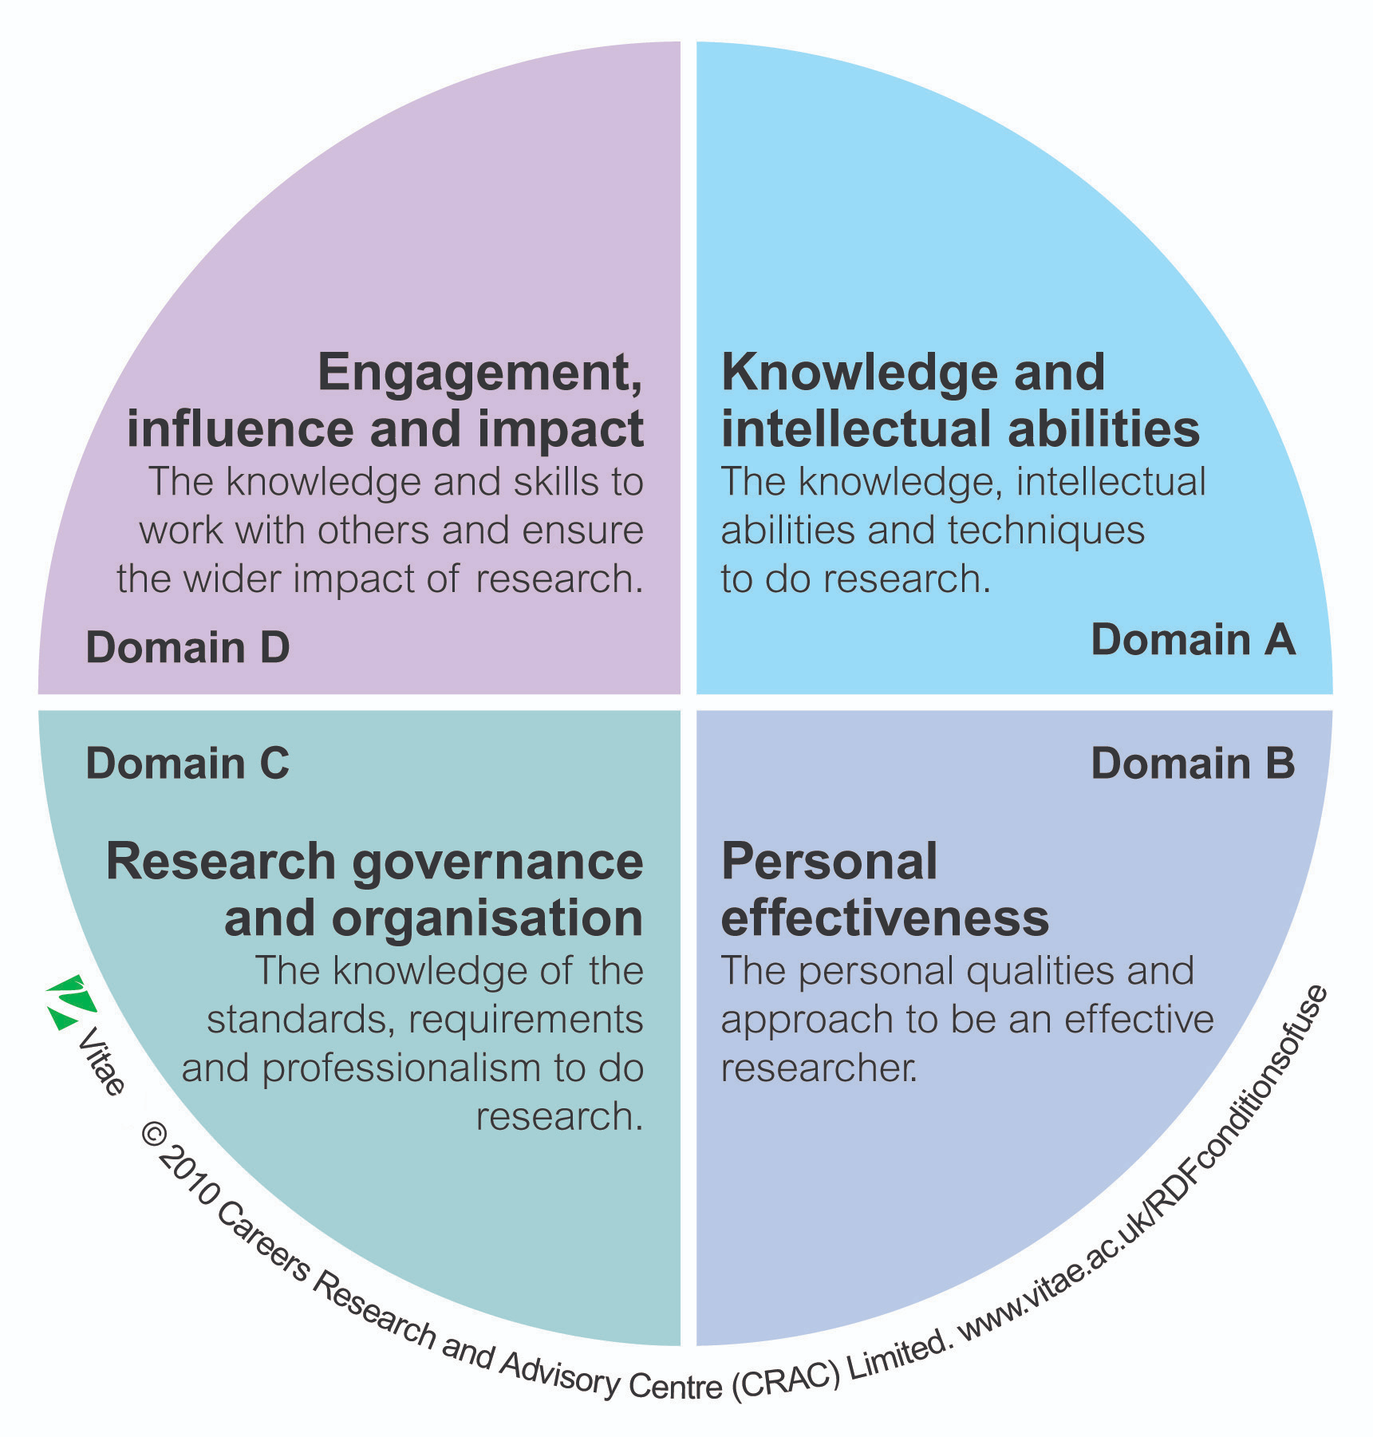
Researcher Development Framework

Slide 11
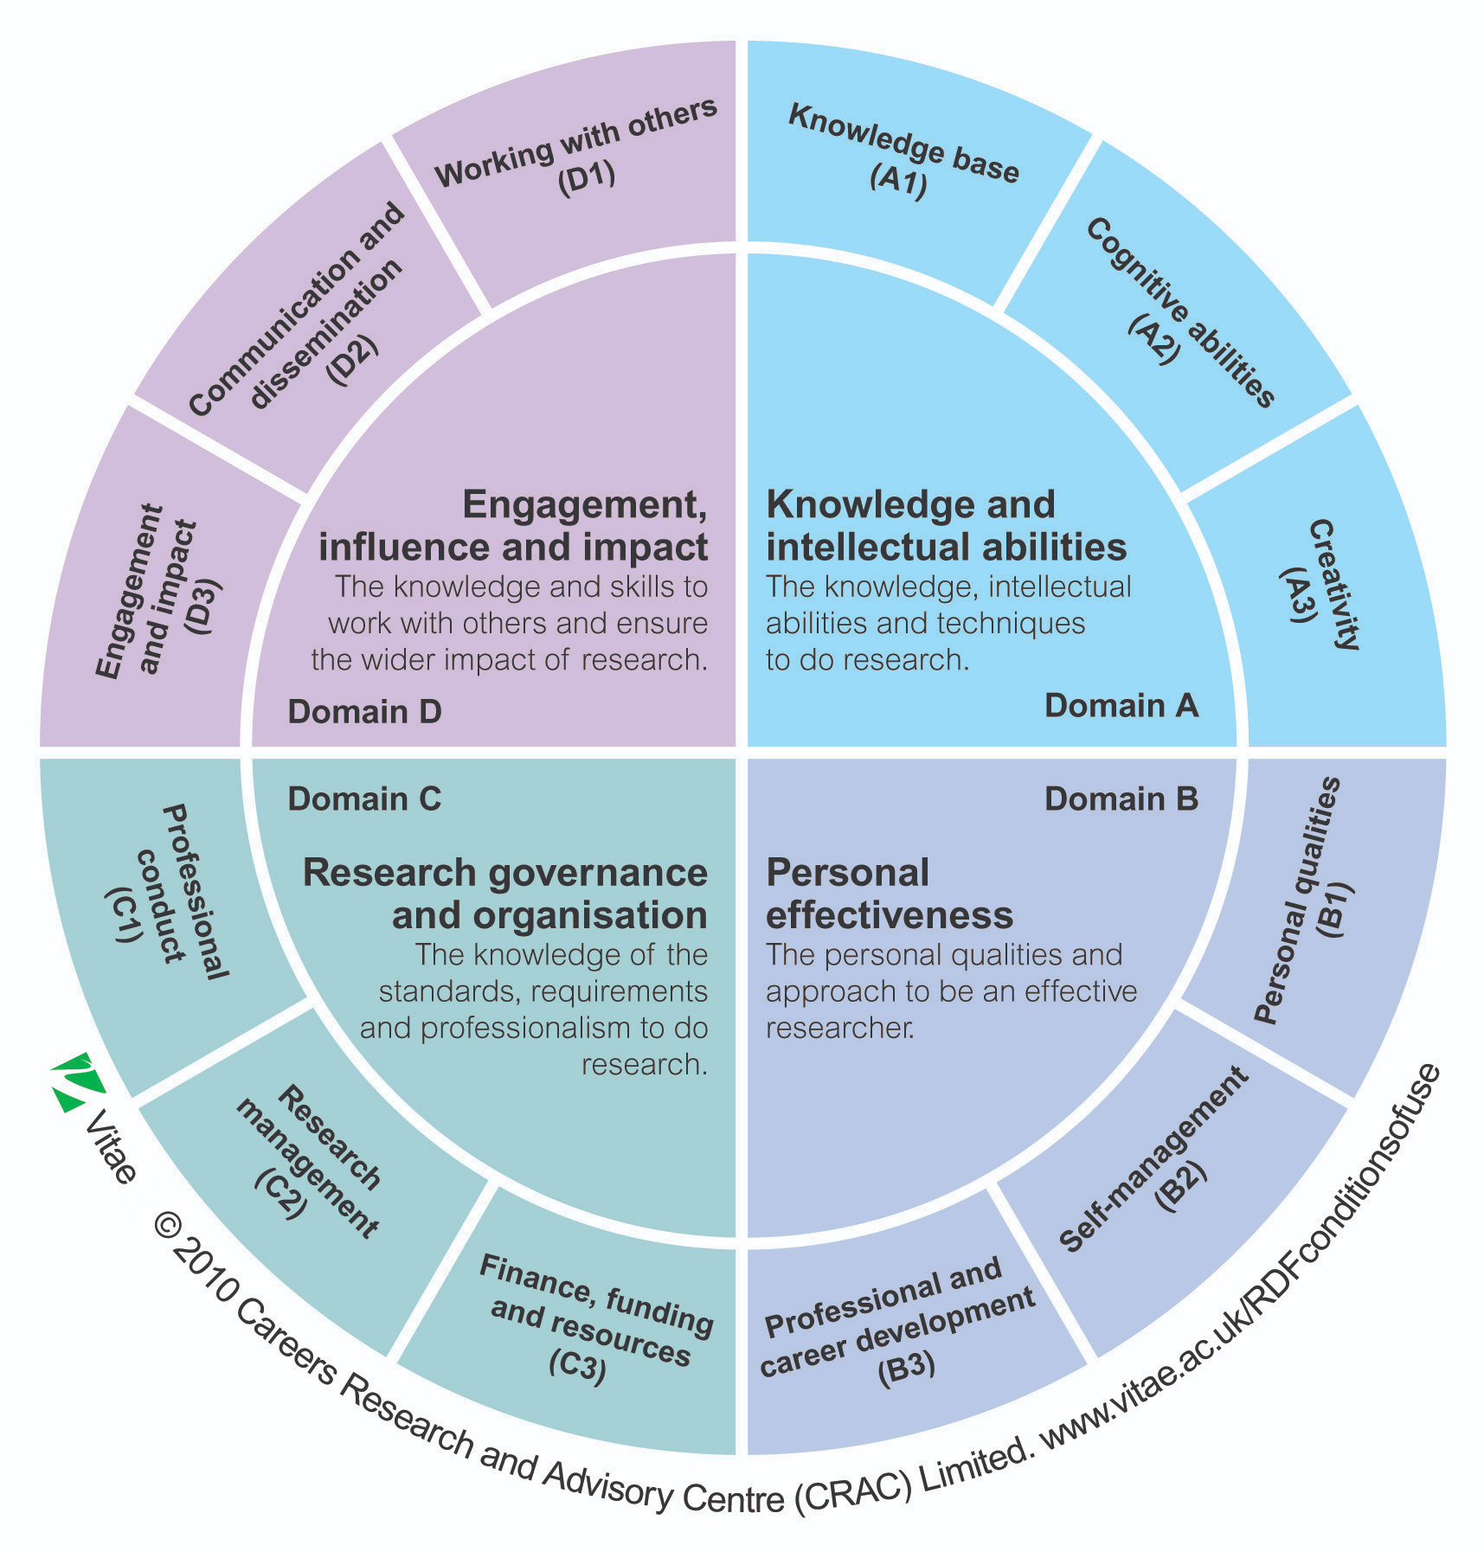

Slide 12
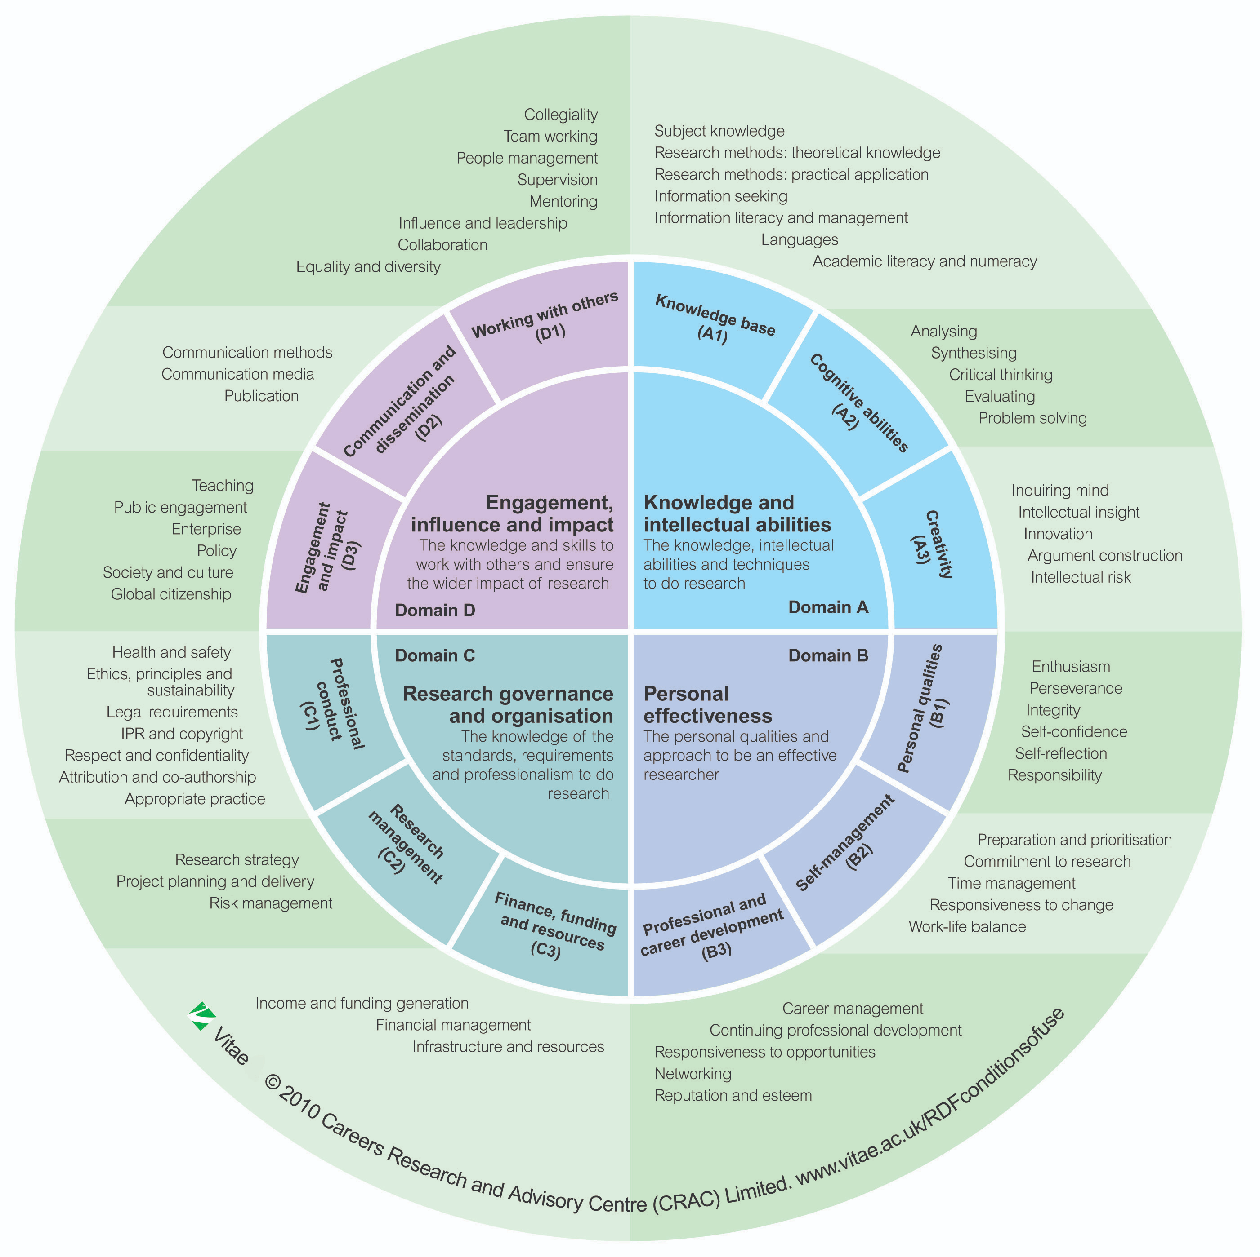

Slide 13
PhD Journey
Year 1
October
Training Needs Analysis
October - September
Year 2
October
Year 3
October
Training of basic skills
July
SeNSS Annual Conference
Training Needs Analysis
October - September
Training of basic skills
Developing employability skills (Placements, Overseas Institutional Visits, Conferences etc)
July
SeNSS Annual Conference
Training Needs Analysis
October - September
Training of basic skills
Developing employability skills (Placements, Overseas Institutional Visits, Conferences etc)
July
SeNSS Annual Conference

Slide 15
Training Needs Analysis
Qualtrics Survey – October
Two parts
Quantitative – Assessments of skills building on Researcher Development Framework
Qualitative – Evaluation of training opportunities and links with previous year’s responses
Informs:
SeNSS training development (On-line and Face to Face)
Pathway training offering

Slide 16
Types of training
SeNSS training - Social Sciences training following the ESRC training guidelines
Face to face (currently on hold)
Virtual (Since March 2020)
UEA/SeNSS collaboration
Annual Conference (usually in July)
Virtual Learning Environment
Institutional offerings
Training offered by Doctoral Colleges or Graduate Schools
Pathway offerings
Training provided by pathways using the Student Cohort Development Fund
Workshops, Mini conferences, Advanced training
Individual student
Use of Research Training Support Grant

Slide 17
Training (SeNSS Offered)
SeNSS Virtual Learning Environment
UEA SeNSS On-line training
SAGE Campus Suite from SeNSS

Slide 18
Placements
Placements involve you going to work with a partner organisation for an agreed period on a defined project or research area.
Placements can be flexibly designed to meet the needs of the project, as well as with your individual training and development needs, and can vary in length, hours worked, and location.
Placement funding aims at supporting and encouraging researchers to engage with business and industry, and is intended to provide you with the opportunity to:
establish research networks and develop your cohort-building skills and contacts;
gain experience within a non-academic environment, which supports personal development;
disseminate early research findings, and gain new insights into your own research project, as well as how different research projects are established and managed; and,
learn new skills, and enhance your employability prospects through experiencing other workplaces.

Slide 19
How do I identify a placement opportunity?
SeNSS will negotiate a placement with one of its existing partners
develop a placement with an organisation that you or your supervisor has already developed a relationship with, or would like to develop a working relationship with.
UKRI/the ESRC advertise competitions for specific placements.

Slide 20
What does placement funding cover and am I eligible?
An extension to your award of up to 3 months
A maximum of £1,500 can be awarded towards reasonable costs.
In cases where you may need to top-up your funding you may apply to use your Research Training and Support Grant (RTSG) funds.
----------
You will not be permitted to undertake a placement during your Masters (+1) year but you can apply for a placement.
any visit in the first year of the PhD must not commence within the first three months of the studentship period.
you must complete your project at least three months before the end date of your studentship award period.

Slide 21
Overseas Institutional Visits (including Virtual)
An OIV is a working visit, for up to three months, to a Higher Education institution, or an organisation with a substantive research office, outside of the UK. OIV awards are normally made for visits to universities but, in exceptional circumstances, applications to appropriate research organisations may be considered.
The aim of an OIV is to support and encourage students’ international engagement. An OIV is intended to provide you with the opportunity to:
Establish research networks and develop your cohort-building skills and contacts;
Disseminate early research findings;
Participate in seminars and other academic activities that are directly relevant to your research, but held overseas;
Undertake specialist research training that is not available within the UK.

Slide 22
What does OIV funding include and am I eligible?
If you are awarded an OIV, you will receive an extension to your studentship of up to three months, plus
A maximum of £3,000 towards reasonable travel and subsistence costs.
An OIV award can be used to pay for up to three separate visits to the same host organisation during the course of your studentship award period.
Ordinarily, SeNSS OIV funds can only be spent on flights, visa and accommodation
You are expected to apply to other sources for funding, and not just SeNSS. Your supervisor should be able to help you identify other funders you could approach.
You may also be able to use some of your RTSG for OIV costs.
------------------
You will not be permitted to undertake an OIV during your Masters (+1) year. You can apply for an OIV during your Masters
If you are undertaking an OIV in the final year of your studentship, you must complete your OIV at least three months before the end date of your studentship award period.
You can only be awarded OIV funding once during the period of your studentship.

Slide 23
Application process
The process is the same for both placements and OIV’s
Apply at least 3 months before you plan undertake either, as this includes completing your university’s risk assessment, and getting travel insurance
Make a formal application, using SeNSS form, available on VLE
Get your supervisor to write a supporting statement
Submit to SeNSS Training Manager for approval who will for forward your application to Training, Employability and Development (TED) Group.
OIV’s and Placements are reviewed by TED and will make a decision on your application within 14 days of application
If you don’t think SeNSS’s decision is fair and rational, you can appeal using the SeNSS Appeals process

Slide 24
References
HEFCE (2011) PhD Study: Trends and profiles 1996-97 to 2009-10 Higher Education Funding Council for England
James, W. (1903) ‘The PhD Octopus’ in (1911) Memoirs and Studies, Longman
Kehm, B. (2007) ‘Doctoral education in Germany: between tradition and reform’, in S Powell and H Green The Doctorate Worldwide, SRHE/Open University Press
Nerad, M. (2009) ‘Confronting common assumptions’ in RG Ehrenburg & CV Kuh (eds) Doctoral Education and the Faculty of the Future Cornell University Press
Simpson, R. (1984) How the PhD came to Britain, SRHE
Vitae (2013) What do Researchers Do? Careers Research and Advisory Centre

Slide 25
OIV
Fourth year (originally planned to be second year)
UCLA Jan 2022 – April 2022 (3 month OIV)
PhD in OCD → UCLA OCD, Anxiety, and Tic Disorder Clinic.

Slide 26
How my OIV fit in to my PhD experience
Fourth year (originally planned to be second year)
Develop skills/experience for final part of PhD → opportunity to share research findings/reflect on how ran final PhD project/establish research networks.
Valuable experience → PhD (see how other labs are run, develop knowledge in PhD subject and related areas, meet renowned researchers in the field, welcomed ‘break’ from PhD research – felt more refreshed, able to concentrate on thesis when got back), personally (living abroad [in a pandemic], explore new places, meet new people, opened up thoughts/opportunities to work abroad in the future).

Slide 27
Process of identifying OIV
Email from SeNSS
Discussed with Supervisor
Researched possible Universities/Researchers
Refined with Supervisor
Reached out to possible host University/Researcher
Wrote application
Liaising with SeNSS throughout for help with any questions.

Slide 28
Significant challenges
Getting the OIV organised → identifying/sorting accommodation (particularly for 3 month stay)
Visa → long process, lots of stress (kindly support by Paul from SeNSS). Took at least 6 months for Visa to be sorted.
OIV plan not being implemented → having to push to do things listed on the plan.
Despite challenges – would highly recommend.

Slide 29
Critical lesson/skill developed
Just going for it/ saying yes to opportunities you perhaps hadn’t thought of before.

